Slide 1

LIRI BOT
Screen SHOTs

Slide 2
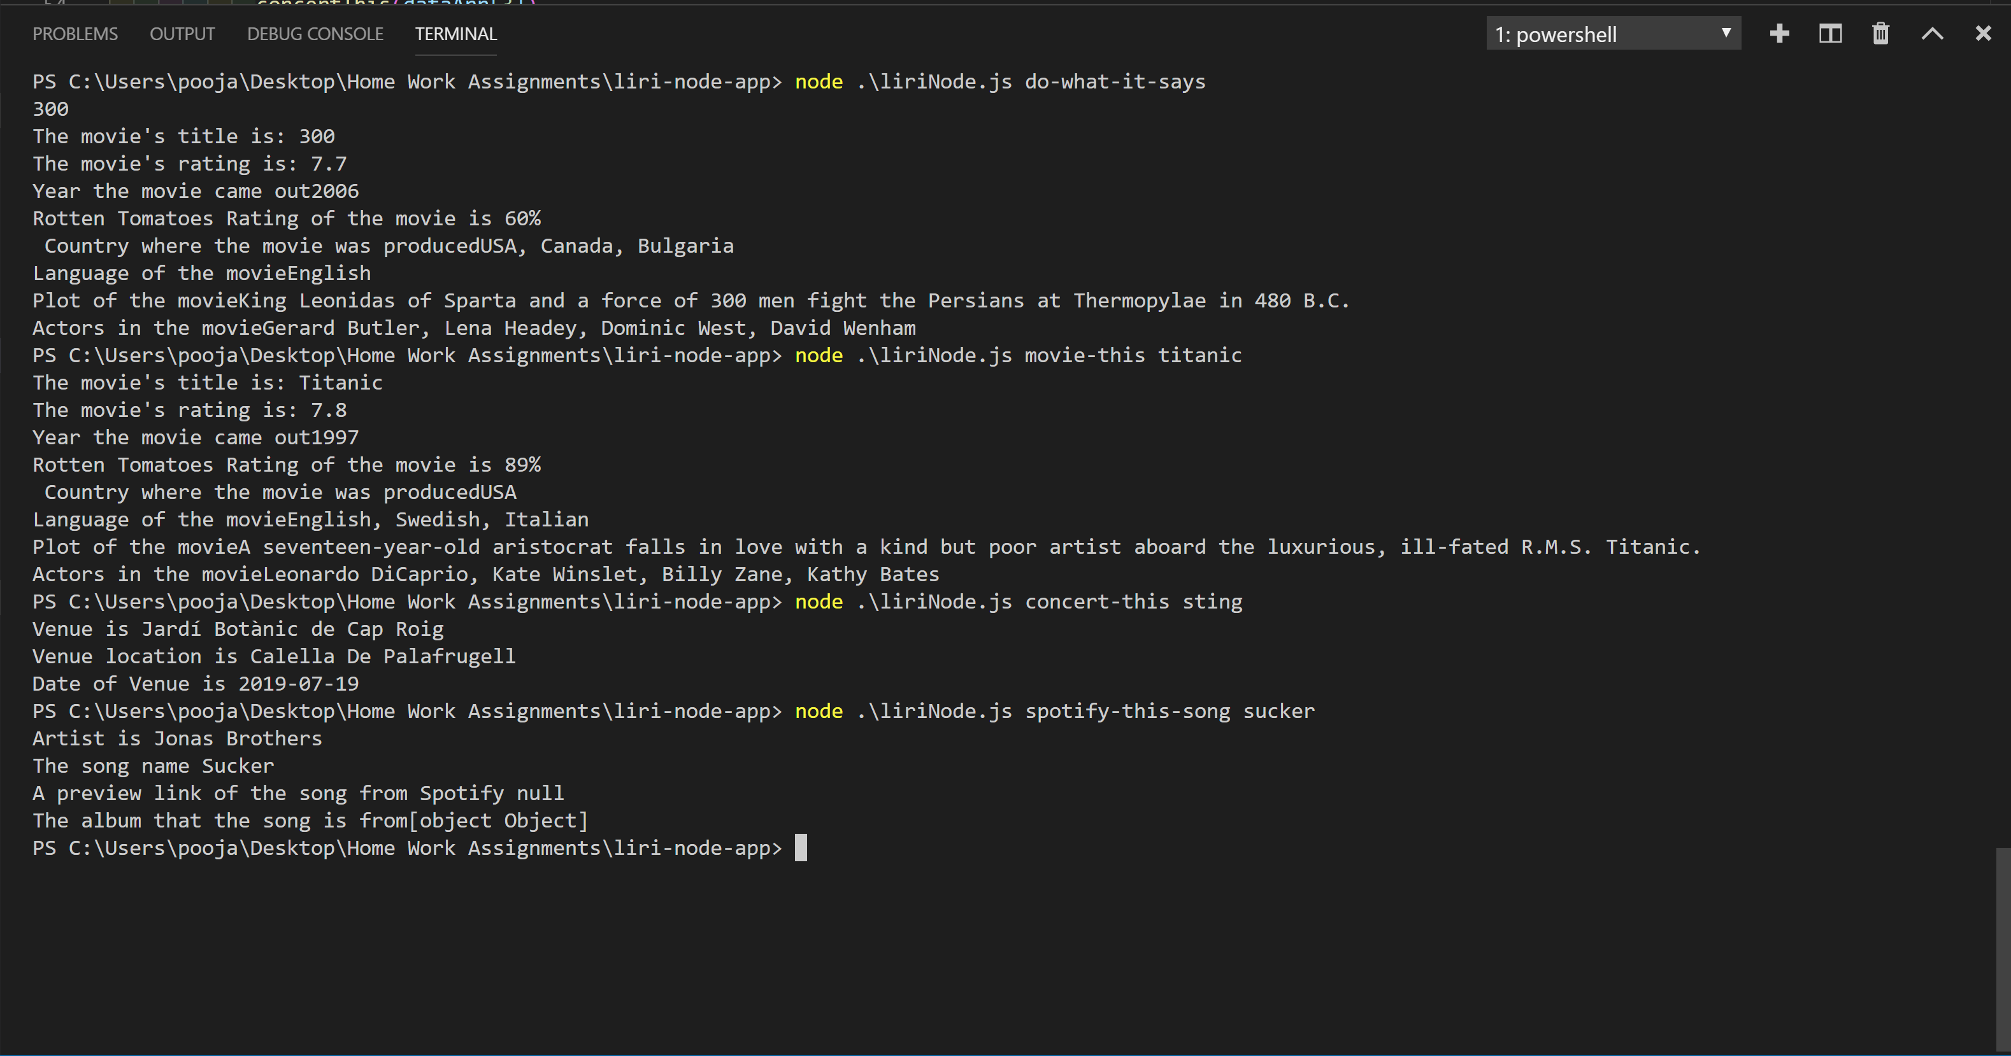
CLI Instruction Screen SHOTS

